Slide 1


Explore Meta Kaggle Dataset to Optimize
User Experience
Team 2
Huiling Cui, Shay Chen,
Linda Qibing Li, Yiqing Lu,
Jianglan Shi, Jingjing Yang
Notes:
Linda

Slide 2
Agenda
Client Scenario
Data Schema
ER Diagram/Normalization
ETL Process
Analytical Procedures
Dashboard
Notes:
Linda

Slide 3

Proposal: Client Scenario
The Kaggle Team hopes to learn more about the dataset, Meta Kaggle, and create more values from it.
We are hired by Kaggle to analyze its competition dataset, Meta Kaggle.
The Kaggle Team hopes to spark some lively Kaggler conversations and provide a more useful resource for the larger data science community.
Notes:
Linda

Slide 4
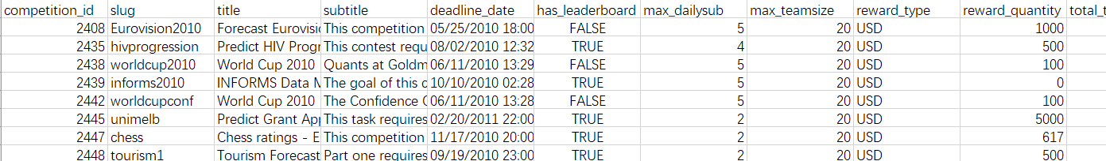
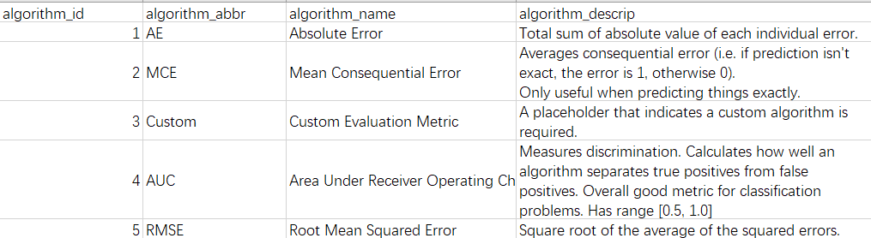
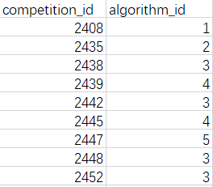
Data SchemaD
To explore more about the competitions in Kaggle, including but not limited to the most frequently used algorithms, organizations held most competitions, and further insights. We created decent views and dashboards based on Meta Kaggle datasets
Sample on the right shows two main tables and a bridge table. This design of dataset schema reduces the redundant of each table and their connection
Based on the schema, queries took less time in Postgresql
Sample (competition, algorithms)
Notes:
Huiling

Slide 5
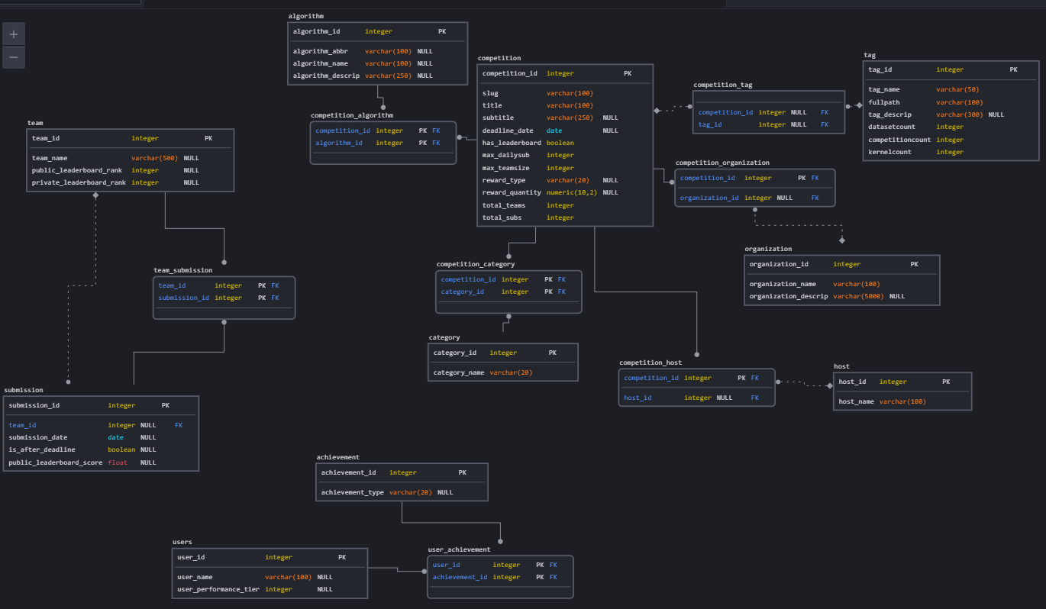
ER Diagram
Notes:
Jianglan

Slide 6
ER Diagram/Normalization
upper
Team/team_sub diagram:
3 tables
Checking for specific team submissions
Upper-right part
Competition Normalization diagram:
11 tables included
Competition, tag, algorithm, organization, host, company information and their bridge tabales.
Search competition information/details
user/user_achievement diagram:
Notes:
jianglan

Slide 7
ETL Process with Python
Original csv files were downloaded from Kaggle, for the purpose of data extraction (8 original datasets)
https://www.kaggle.com/datasets/kaggle/meta-kaggle?select=Competitions.csv
Extract
Used pandas package in Python to select and append the columns from raw datasets
Merged some tables to create designed bridge tables
Operated it in Python to make sure the tables match the designed schema in postgresql
Transform
Load
Loaded data utilizing sqlalchemy to connect Python with SQL database (17 tables in 3NF)
https://github.com/mc4564/APAN5310SQL
Notes:
Shay

Slide 8
Analytical Procedures
13 analytical procedures formed based on questions that analysts would ask
SQL, Python, and Metabase for data exploration
Explored historical data and factors associated with competitions
Focused on queries using arithmetic, GROUP BY, ORDER BY, etc.
Analytical results are for C-suite while coding for analysts
Notes:
Jingjing
After the data cleaning process, we used SQL, Python and Metabase for further analysis. We mainly focused on competition data and developed 13 views with Postgres pgAdmin to show the results.
Next Slide

Slide 9
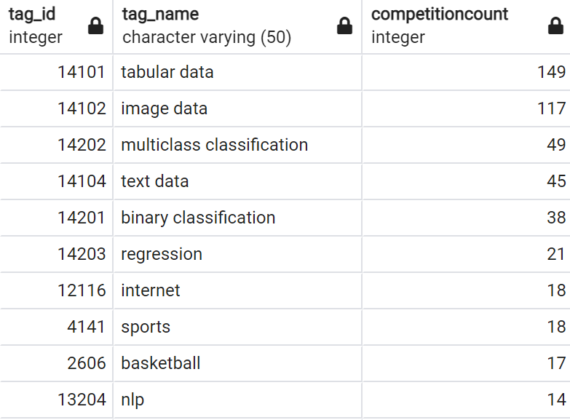
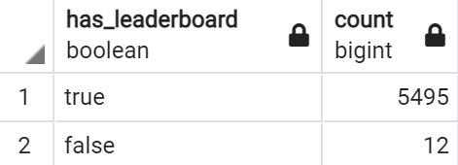
Analytical Procedure Examples
Question | Code | Result
What are the most frequently used tags for competitions? C-suite: interested in understanding the tags associated with past competitions, in order to decide the necessity of diversifying competition topics to keep more users active on Kaggle | SELECT tag_id, tag_name, competitioncount FROM tag ORDER BY competitioncount DESC LIMIT 20;
Does the existence of leadership boards encourage more participants? C-suite: interested in whether to suggest new and existing hosts to set up a leadership ranking, in order to stimulate higher participation rate | SELECT competition.has_leaderboard, COUNT(competition_id) FROM competition GROUP BY competition.has_leaderboard ORDER BY COUNT(competition_id) DESC;
Notes:
Jingjing
2 examples for analytical applications we demonstrate here are.
First, what are the most frequently used tags for competitions?
Tags, such as tabular data, image data, multiclass classification are used to describe the characteristics or topics related to the specific competition.
There are 320 tags available in total, 700 competitions are associated with valid tag data. The Top 5 tags are contained in 57% of all competitions. We believe Kaggle should consider increase diversification of its competitions. Hence, to attract different users to dabble on various competition topics. This can also create new challenges for users and increase their loyalty and activeness on Kaggle.
Second, we noticed that some competitions don’t have leadership board to show the live ranks. This question can be used for C-suite to suggest external hosts to set up a leaderboard or not.
Yiqing

Slide 10
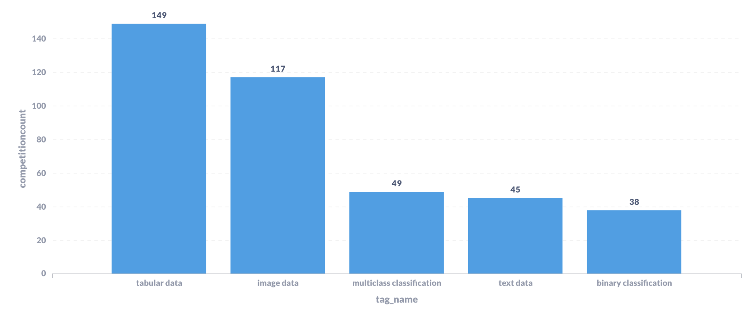
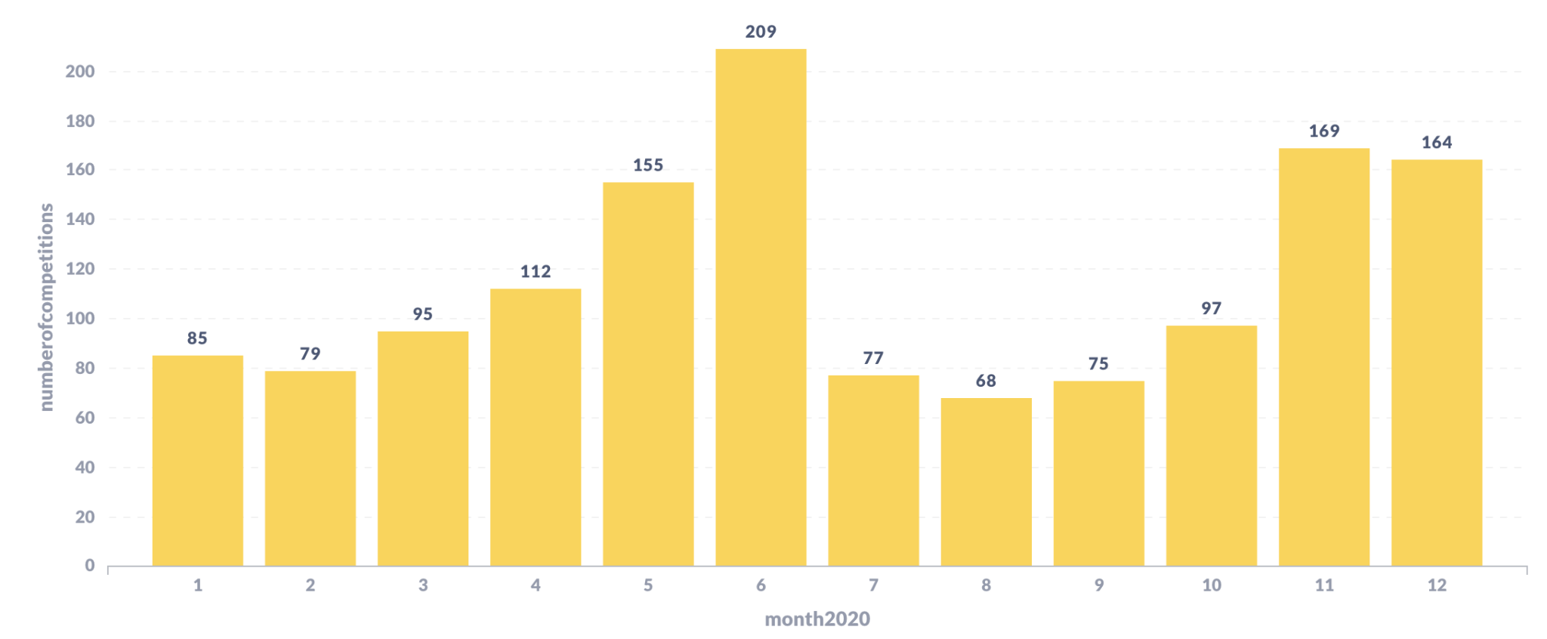
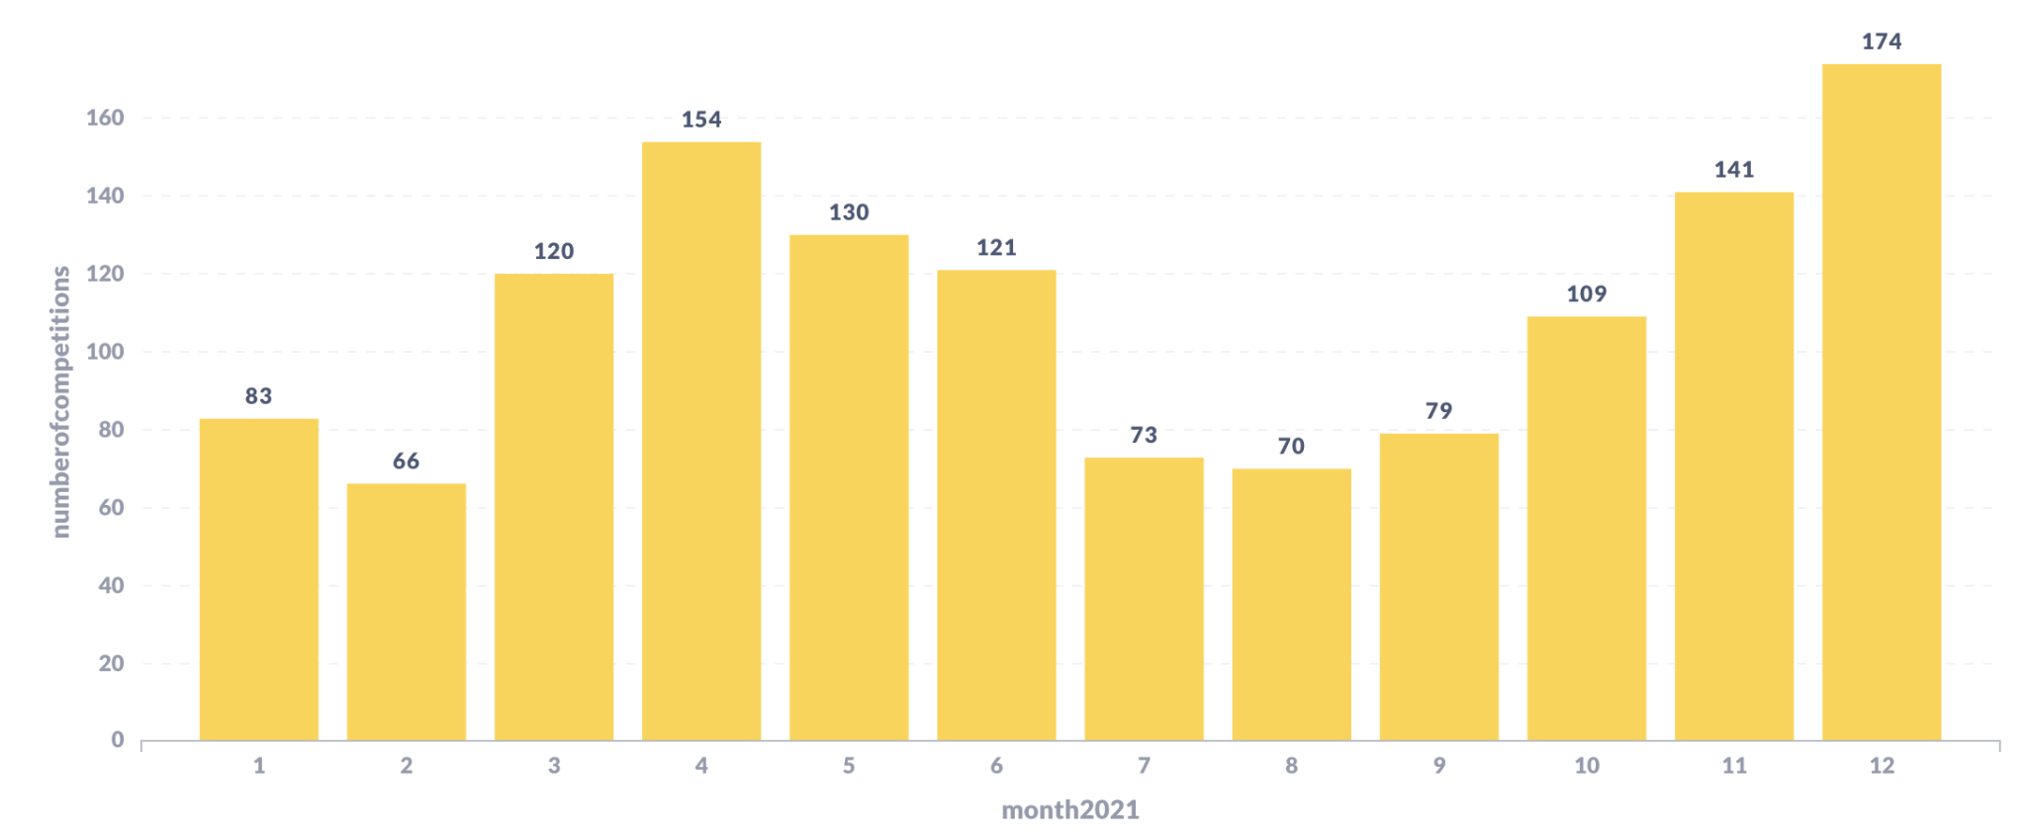
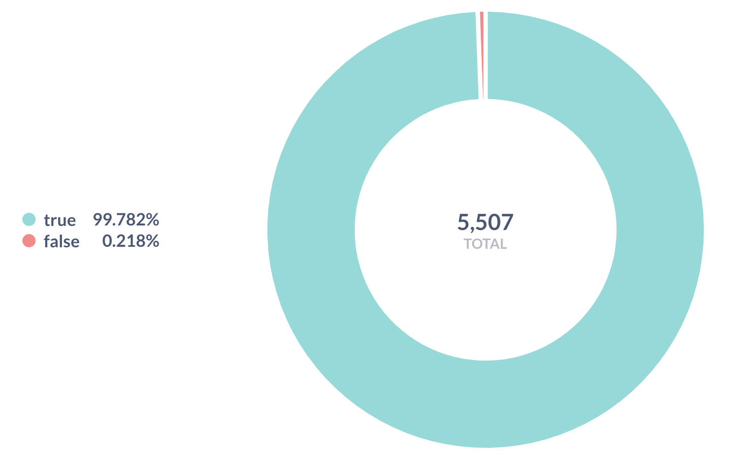
Dashboard Example
Top 5 most frequently used tags across all competitions
Users are more active if competition has a leaderboard
Number of competitions held in each month in Year 2020 & Year 2021
Notes:
Yiqing
This slide is a visualization of previous analytical application examples.
On the left side, we are showing the visual representation of analytics examples
In the past 12 years, Kaggle held most competition in the year of 2020 and 2021. Therefore, we want to closely investigate if there was a seasonality of holding competitions.

Slide 11
Thank you!
We are happy to take any questions : )
Notes:
Yiqing
conclusion

